Slide 1
WAIU – Experience Luxury At Convenience

Slide 2








Truevibez : Mission, Vision & Values
Mission:
To create a global service provider of hospitality industry, realizing pioneering advancements in established services and accomplish mutual growth for both our partners & customers
Vision:
Truevibez is dedicated to provide modern & innovative solutions to our hospitality partners, via introduction of technology evolution in their offerings and creating avenues of inspiring new business horizons.
Values:
Innovation through Leadership : To become vanguard of hospitality experience enrichment
Modernization & Elegance : To develop ultramodern hospitality business solutions
Focus & Evolution : Relentlessly strive to improve business value through performance

Slide 3
Founder : Rajesh Karandikar
Rajesh Karandikar is owner of Hotel 24K chain of restaurants in Maharashtra (MH) & Director of Truevibez Pvt. Ltd.
Rajesh is a government media partner as an empanelled member of DGIPR & has executed a range of promotional and awareness campaigns such as:
Edutainment program for Primary & Secondary school in collaboration up with Discovery channel
Cloud seeding program across MH in 2018 under Ministry of Earth Sciences
Executed disaster management week with NDRF for government offices & schools, in 463 tehsils
Rajesh holds MBA in Marketing stream & after spending time at several corporate positions in Delhi, Mumbai & Pune, he applied his entrepreneurial skills in hospitality industry and started the Hotel 24K chain of restaurants, originating in Kolhapur, Maharashtra.
The implementation was an instant success, something which he has now replicated in Pune at premium locations as Balewadi High Street & Viman Nagar IT City. With 3 active restaurants now, Rajesh is also enrolled as an honorary member of Craft Brewers Association of India, successfully running a Craft Brewery in Pune.
To extend his expertise further in hospitality business, Rajesh has founded company Truevibez Pvt. Ltd., with Alok Sambuddha, that aims to explore and introduce innovative technology solutions in hospitality industry to take customer experience to completely new & unexplored levels.

Slide 4
Founder : Alok Sambuddha
Alok Sambuddha is Engineering Director in American Express, United Kingdom & Director of Truevibez Pvt. Ltd.
Alok is a Mechanical Engineer from Pune University with broad experience in IT industry, working with prominent MNCs as Cisco, Infosys, Atos and now American Express.
Alok’s specializes in merchant acquisition domain and developing technical platforms to support end to end merchant lifecycle services such as affiliation, enablement, submissions, payments, reconciliation, compliance, MIS, AML, Risk, Finance & Accounting.
He also leads solution development framework across technologies like Mainframes, Java, Dot Net, supported via both Agile & Waterfall delivery models. He provides corporate and architectural consultation to business & technology teams to develop flexible solution frameworks & heads the implementation committee.
Alok’s primary geography of operation is Europe (EMEA) and has spent most of his career in Brighton, UK, at the European technology head office of American Express.
Alok has critical presence in merchant management landscape and aims to extend his experience through technical evolution of traditional hospitality business and modernize the F&B service offering for digital citizens in partnership with Rajesh Karandikar.

Slide 5
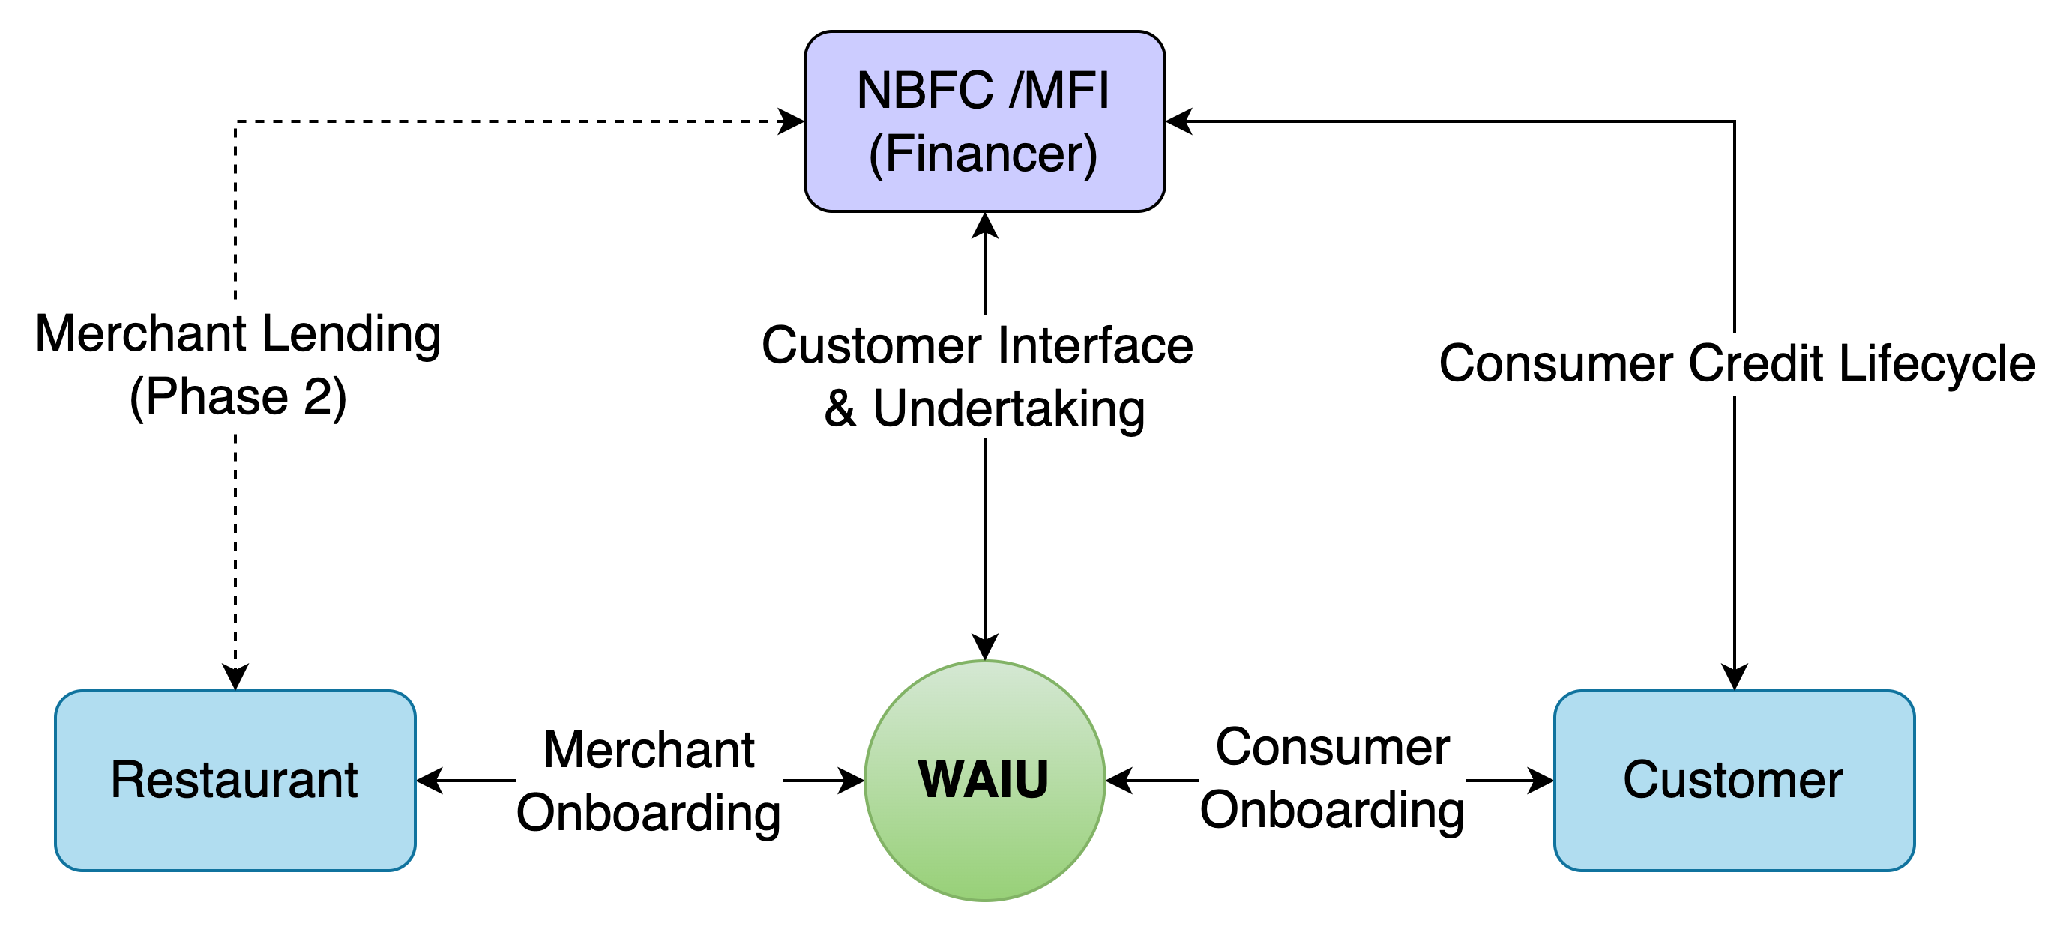
WAIU – High Level System Flow
WAIU pilot is planned in Kolhapur, Maharashtra in April-2022, with in initial partnerships with 50 top restaurants.
WAIU launch is planned in Pune, Maharashtra in April-2022, with in initial partnerships with 200 top restaurants.
By end of 2022, WAIU will be expanded in 10 key cities across India, with a partner merchant base of 3000+
Each restaurant to have average of 5000+ customers per restaurant, allowing a significant platform coverage
Platform development is complete with merchant signup & brand positioning and collaterals in design
WAIU will start services in Tier-2 cities in 2023, to support its NBFC partners already operational there
Wider WAIU Phase-2 features, including merchant lending, will be launched in Q3 2022.

Slide 6
Strategic Alliance – WAIU & Amhi Kolhapuri
Both WAIU & Amhi Kolhapuri are aiming to bring lively people of Kolhapur together in their own ways
In past 5 years, familiarity of digital services & ecommerce has increased sharply in Kolhapur
Average Kolhapuri resident is now spending more on lifestyle & convenience products than ever before
More partnerships will provide innovative online features for the most loved aspect in Kolhapur– Kolhapuri Cuisine !!
Amhi Kolhapur & WAIU will create first wave of new-age services in Kolhapur, to achieve mutual success for many years
In coming weeks, we have also planned to add online restaurant table booking & event management services, to benefit both Kolhapuri residents & restaurants
B2B Service Partnership Highlights
1. Kolhapur launch offers of DNPL & 10% discount to Amhi Kolhapuri members
2. Referral service for Amhi Kolhapuri members, for additional benefits
3. Commercial support to Amhi Kolhapuri promoters
4. Restaurant table, Hotel accommodation and event booking service

Slide 7

+
Amhi Kolhapuri Partnership
WAIU - Amhi Kolhapuri Partnership
Model 1 - Revenue sharing - 5 Years
Total customers | Month 1 | Month 2 | Month 3 | Month 12 | Month 36 | Month 60
Downloads till date | 2500 | 5000 | 7500 | 30000 | 60000 | 100000
Transactions Count @ 10% conversion | 250 | 500 | 750 | 3000 | 6000 | 10000
Average Transaction value | 1500 | 1500 | 1500 | 1500 | 1500 | 1500
Total billing | ₹3,75,000 | ₹7,50,000 | ₹11,25,000 | ₹45,00,000 | ₹90,00,000 | ₹1,50,00,000
Amhi Kolhapuri Commission | 0.10%
Amhi Kolhapuri Earning | ₹375 | ₹750 | ₹1,125 | ₹4,500 | ₹9,000 | ₹15,000
Total Earning At End of Tenure = 7 Lacs
Model 2 - Per download based - 5 Years
Total customers | Month 1 | Month 2 | Month 3 | Month 12 | Month 36 | Month 60
Downloads till date | 2500 | 5000 | 7500 | 30000 | 60000 | 100000
Amhi Kolhapuri Per download rate | 10.00
Amhi Kolhapuri earnings till date | ₹25,000 | ₹50,000 | ₹75,000 | ₹3,00,000 | ₹6,00,000 | ₹10,00,000
Total Earning At End of Tenure = 10 Lacs

Slide 8
Corporate Partnership
S. No. | Partner | Role
1 | NPCI | Nth Reward Loyalty platform onboarding & campaigning platform
2 | Cosmos Bank / Lokmanya Co-Operative Society | Value add service to bank customers via bank's super-app
3 | KPMG | RBI regulatory compliance and licensing services
4 | Payu Finance (Lazypay) | Financial lending service provider
5 | ZestMoney | Financial lending service provider
6 | Early Salary | Financial lending service provider
7 | LoanTap | Financial lending service provider
8 | Michael Dell Foundation | Financial lending service provider
9 | ICICI Bank / Yes Bank | Ongoing discussions on lending options and expansion of services
10 | Suniel Shetty (Popcorn Entertainment) | Brand Ambassador
11 | TOI, Pune Mirror | Media & Advertorials
12 | Sazinga Digital | Technical platform development & maintenance

Slide 9
Our Team
Promoters
Rajesh Karandikar
Alok Sambuddha
Board Of Advisors
Rahul Renavikar :Managing Director, Acuris Advisors (GST & Government Policies) – Ex. Big 4 & Tata Motors
Chetan Oswal : Accounts & Legal Counsel
Shrikant Chatur : Governance Consultant (ex. VP Commercial - Cummins)
Sanjay Phadke : Fintech Specialist, Ex. EVP Edelweiss & Vayana Network, JP Morgan, HSBC
Rakesh Malhotra : Media Curator, Ex. Media Head - Sakal
Yogesh Katre : Sales Head, Loantap
Harun Rashid Khan : Regulatory Advisor, Ex. Deputy Governor RBI
Vinay Baijal : Regulatory Advisor, Ex. CGM Banking, RBI

Slide 10






Question & Answers

